Slide 1
Securitization and Mortgage Crisis: The Fall of The Greatest
Prof. Darko Vukovic
E-mail: vdarko@hotmail.rs

Slide 2
Changes in Housing Finance
Prior to 1970, most mortgage loans would come from a local lender such as a neighborhood savings bank or credit union.
Fannie Mae (FNMA, or Federal National Mortgage Association) and Freddie Mac (FHLMC, or Federal Home Loan Mortgage Corporation).

Slide 3
Pass-through mortgage securities
Pass-through mortgage securities “pass through” promised payments of principal and interest on pools of mortgages created by financial institutions to secondary market investors (mortgage-backed security bond holders) holding an interest in these pools.

Slide 4
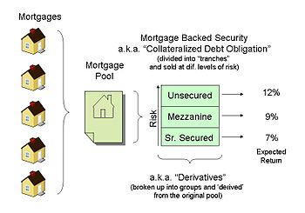

Slide 5
Subprime loans
While conforming loans were pooled almost entirely through Freddie Mac and Fannie Mae, once the securitization model took hold, it created an opening for a new product: securitization
by private firms of nonconforming “subprime” loans with higher default risk.

Slide 6
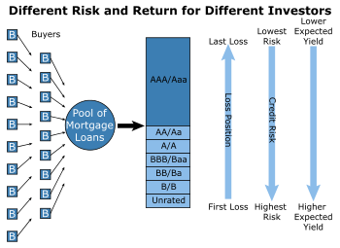

Slide 7
Mortgage Derivatives
New risk-shifting tools enabled investment banks to carve out AAA-rated securities from original-issue “junk” loans.
Collateralized debt obligations, or CDOs, were among the most important and eventually damaging of these innovations.
Credit Default Swaps (SCD).

Slide 8
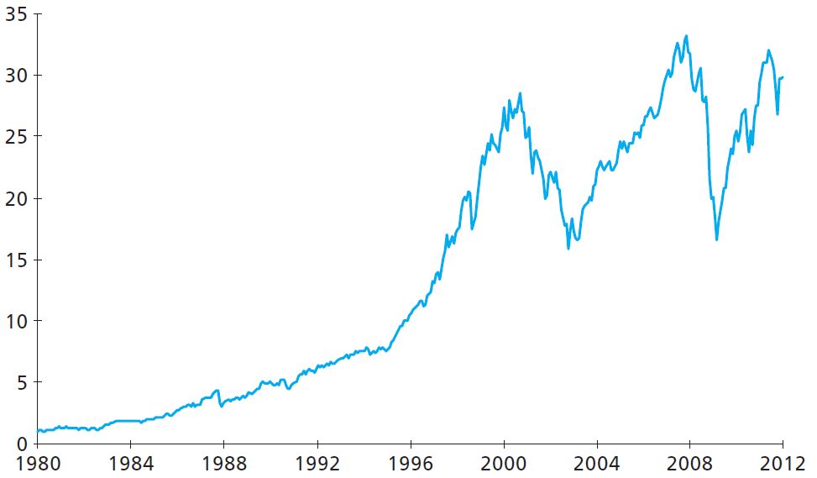
The Rise of Systemic Risk
Cumulative returns on a $1
investment in the S&P 500
Index

Slide 9
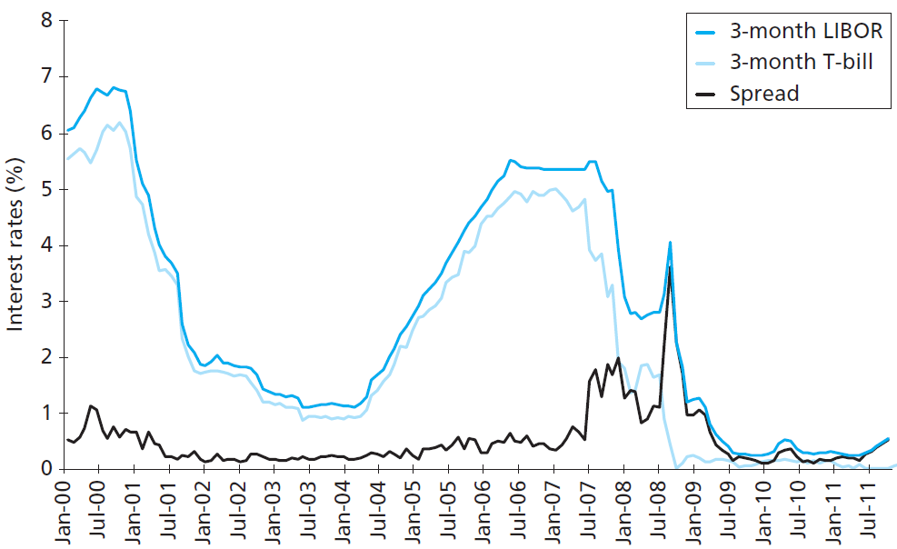
The Rise of Systemic Risk

Slide 10
The crisis
Between August 2007 and October 2008, an additional 936,439 homes were lost to foreclosure.
The Failure of Bear Stearns.
(Goldman Sachs and Morgan Stanley) and these two firms converted to commercial bank holding companies.
Then on Monday, September 15, Lehman Brothers (the 158-year-old investment bank) filed for bankruptcy, Merrill Lynch, rather than face bankruptcy, was bought by Bank of America, AIG (one of the world’s largest insurance companies) met with federal regulators to raise desperately needed cash.

Slide 11
The crisis
Commercial banking giant Citigroup required a massive government guarantee against losses and an injection of cash to prevent failure.
The three major U.S. automakers faced imminent danger of bankruptcy without a federal bailout, and even with the bailout, Chrysler and General Motors declared bankruptcy in May and June 2009, respectively.

Slide 12
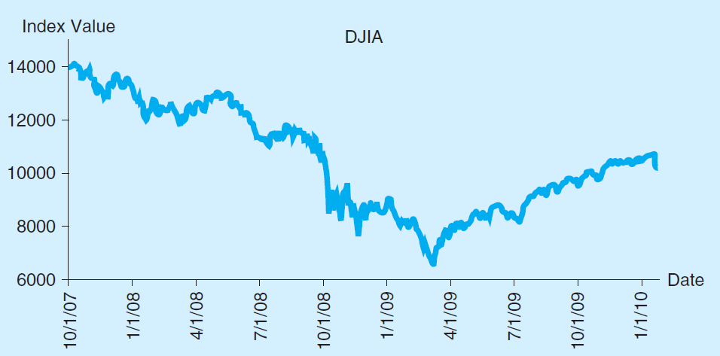
The Dow Jones Industrial Average, October 2007–January 2010

Slide 13
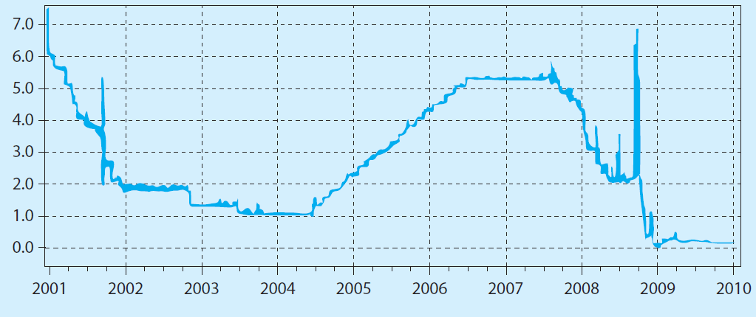
Overnight London Interbank Offered Rate (LIBOR), 2001–2010

Slide 14
Overnight Interest Rates, 1997–2010

